Slide 1
Scheduler
Ryan Tolentino
Miguel Castro
March 28th 2018

Slide 2
Overview
Updated Project Description
Background
Tool & Techniques
Problem Solution
What is Ahead

Slide 3
Project Description
We have decided to create scheduler application that allows two individuals to schedule an activity. Our example in this case is scheduling a tea activity.

Slide 4
Background
Model View Controller Web2py separates the data representation (the model) from the data presentation (the view) and also the application logic and workflow (the controller).

Slide 5
Tools and Techniques
Web2py Web2py is a free open-source web framework for secure database web application. The application uses python and includes a database abstraction layer, therefore it knows how to generate SQL by itself.
SQLDB A database is used for a structured set of data held in the computer. In our application we will be using an SQLDB.
Draw.io Draw.io is a program that allows a user to draw diagrams and flowcharts. We will be using draw.io to create our flow charts and other graphics.
Github a repository to store important elements for the project https://github.com/jangoflyte/Senior-Project

Slide 6
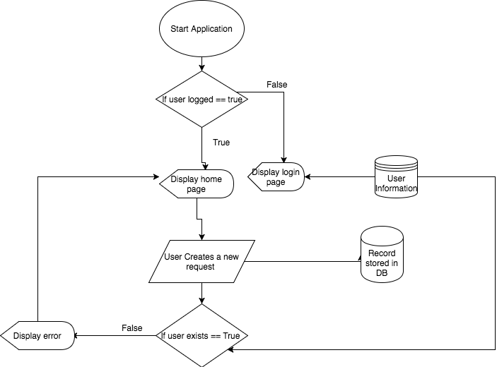
Problem Solution

Slide 7
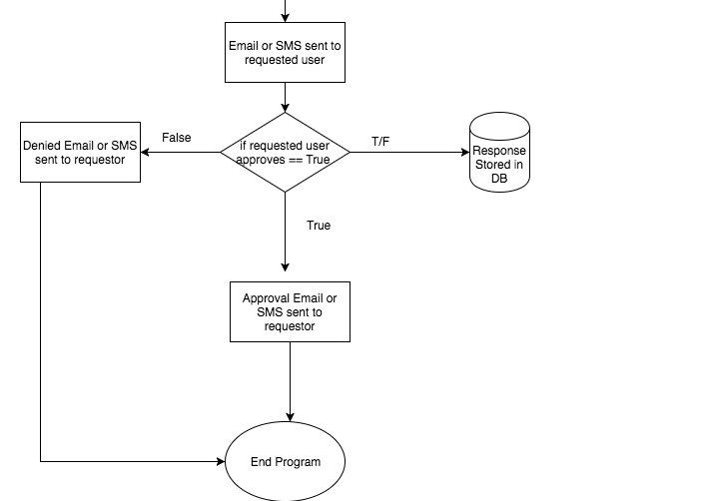
Problem Solution

Slide 8
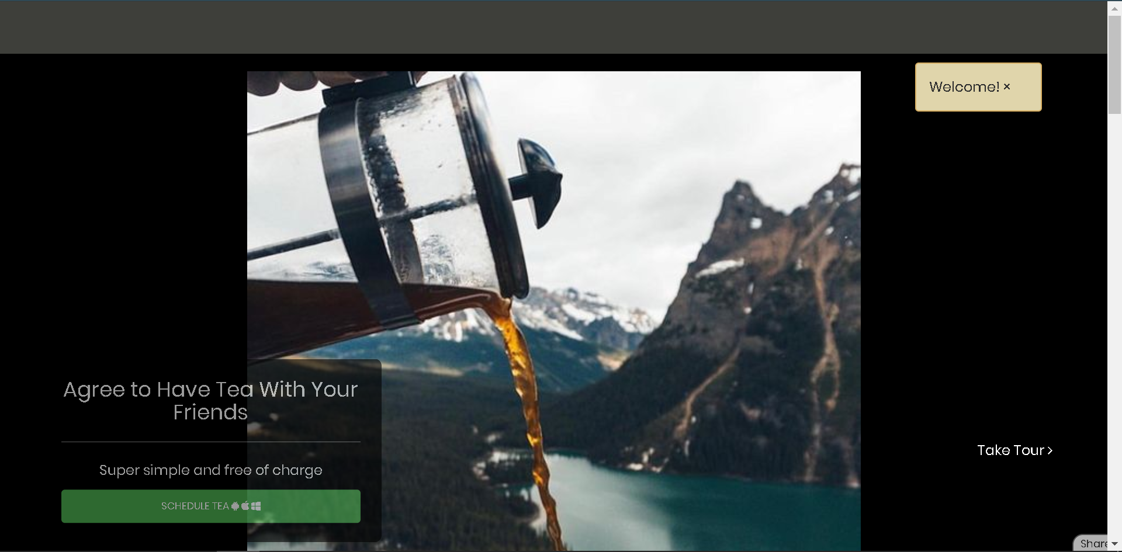
Problem Solution
This is a prototype version of our application, only shows the view mode of the Tea App

Slide 9
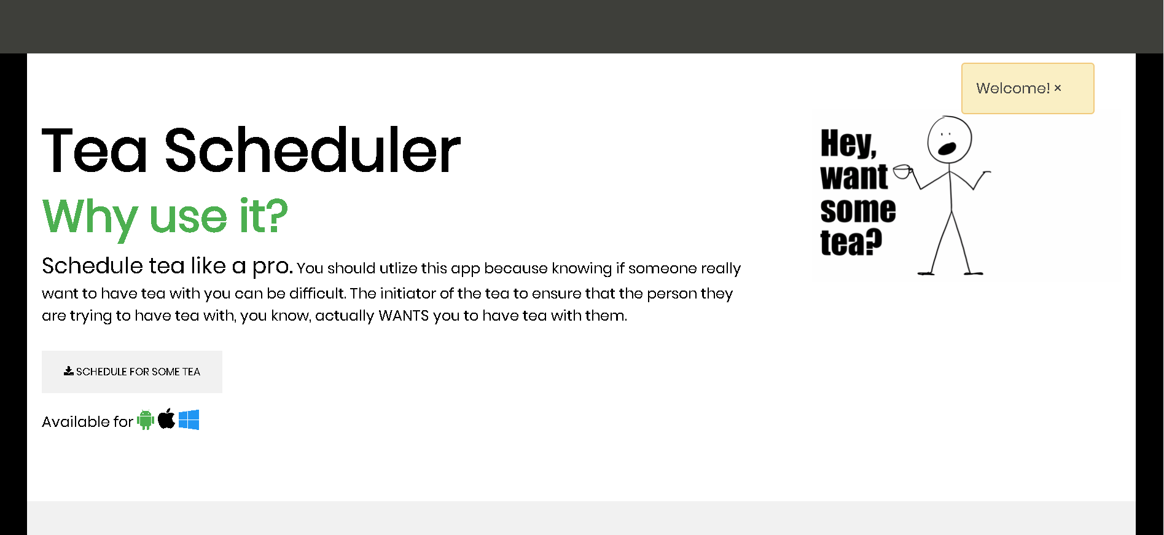
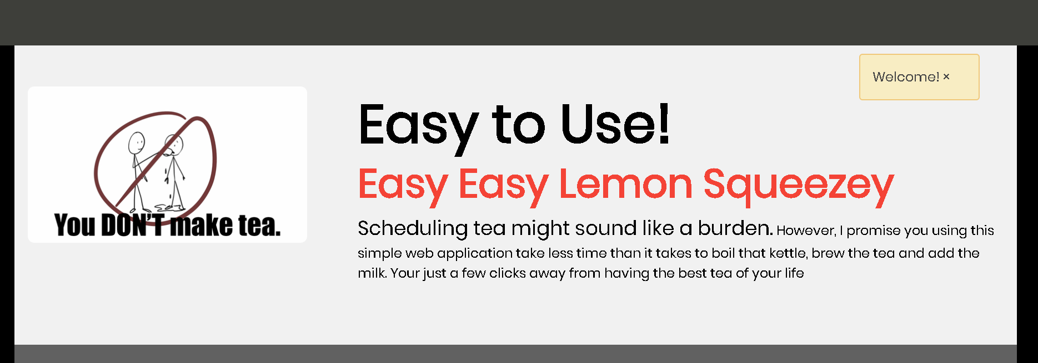

Slide 10
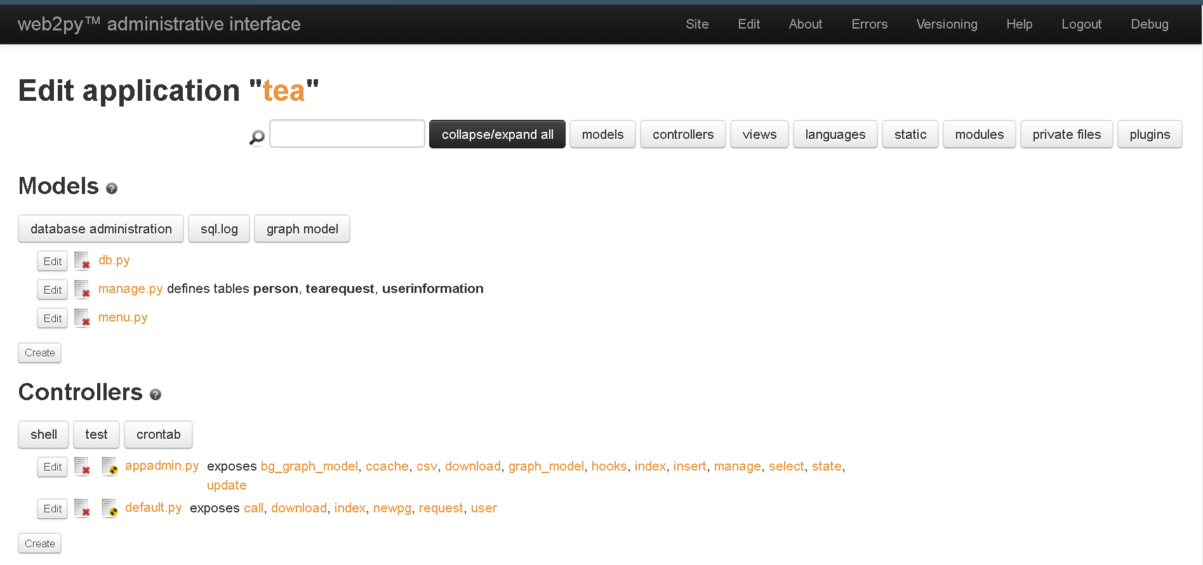
Web2py Admin Interface
This is how we edit the Tea App
It uses the concept of Model View Controller Concept
The framework uses Python, JavaScript, and HTML language

Slide 11
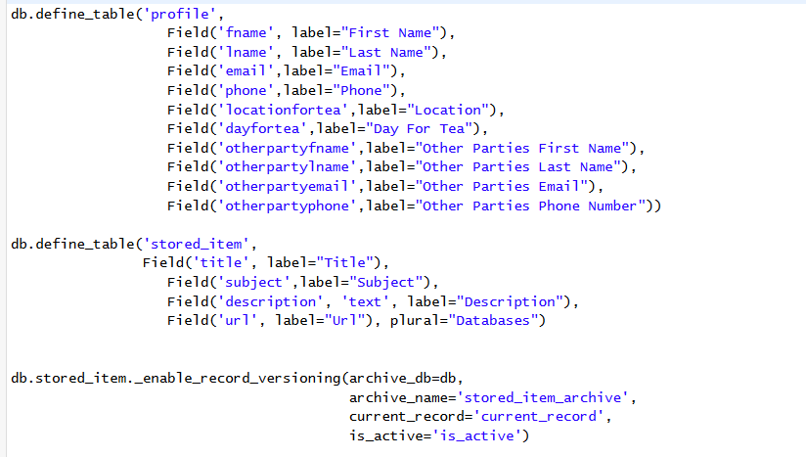
Database Model
We created a table database the defines and stored user information and tea request information
This allows us to request both of the user’s data and allow to schedule the activity

Slide 12
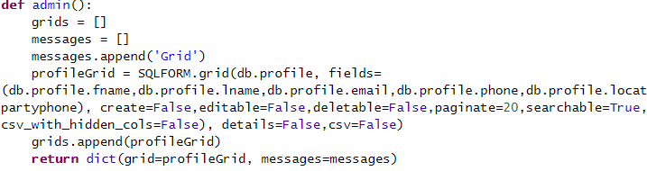
Controller
We created a controller that stores all the inputs from form
This allows us to gather both parties information and to complete the request

Slide 13
What is Ahead
Need to update the application
Perform testing and debugging
Modify or improve logic within the application

Slide 14
Summary
Updated Project Description
Background
Tool & Techniques
Problem Solution
What is Ahead

